Slide 1
Genre Classification of Midi Files
Anish Shah, Nick Torba

Slide 2
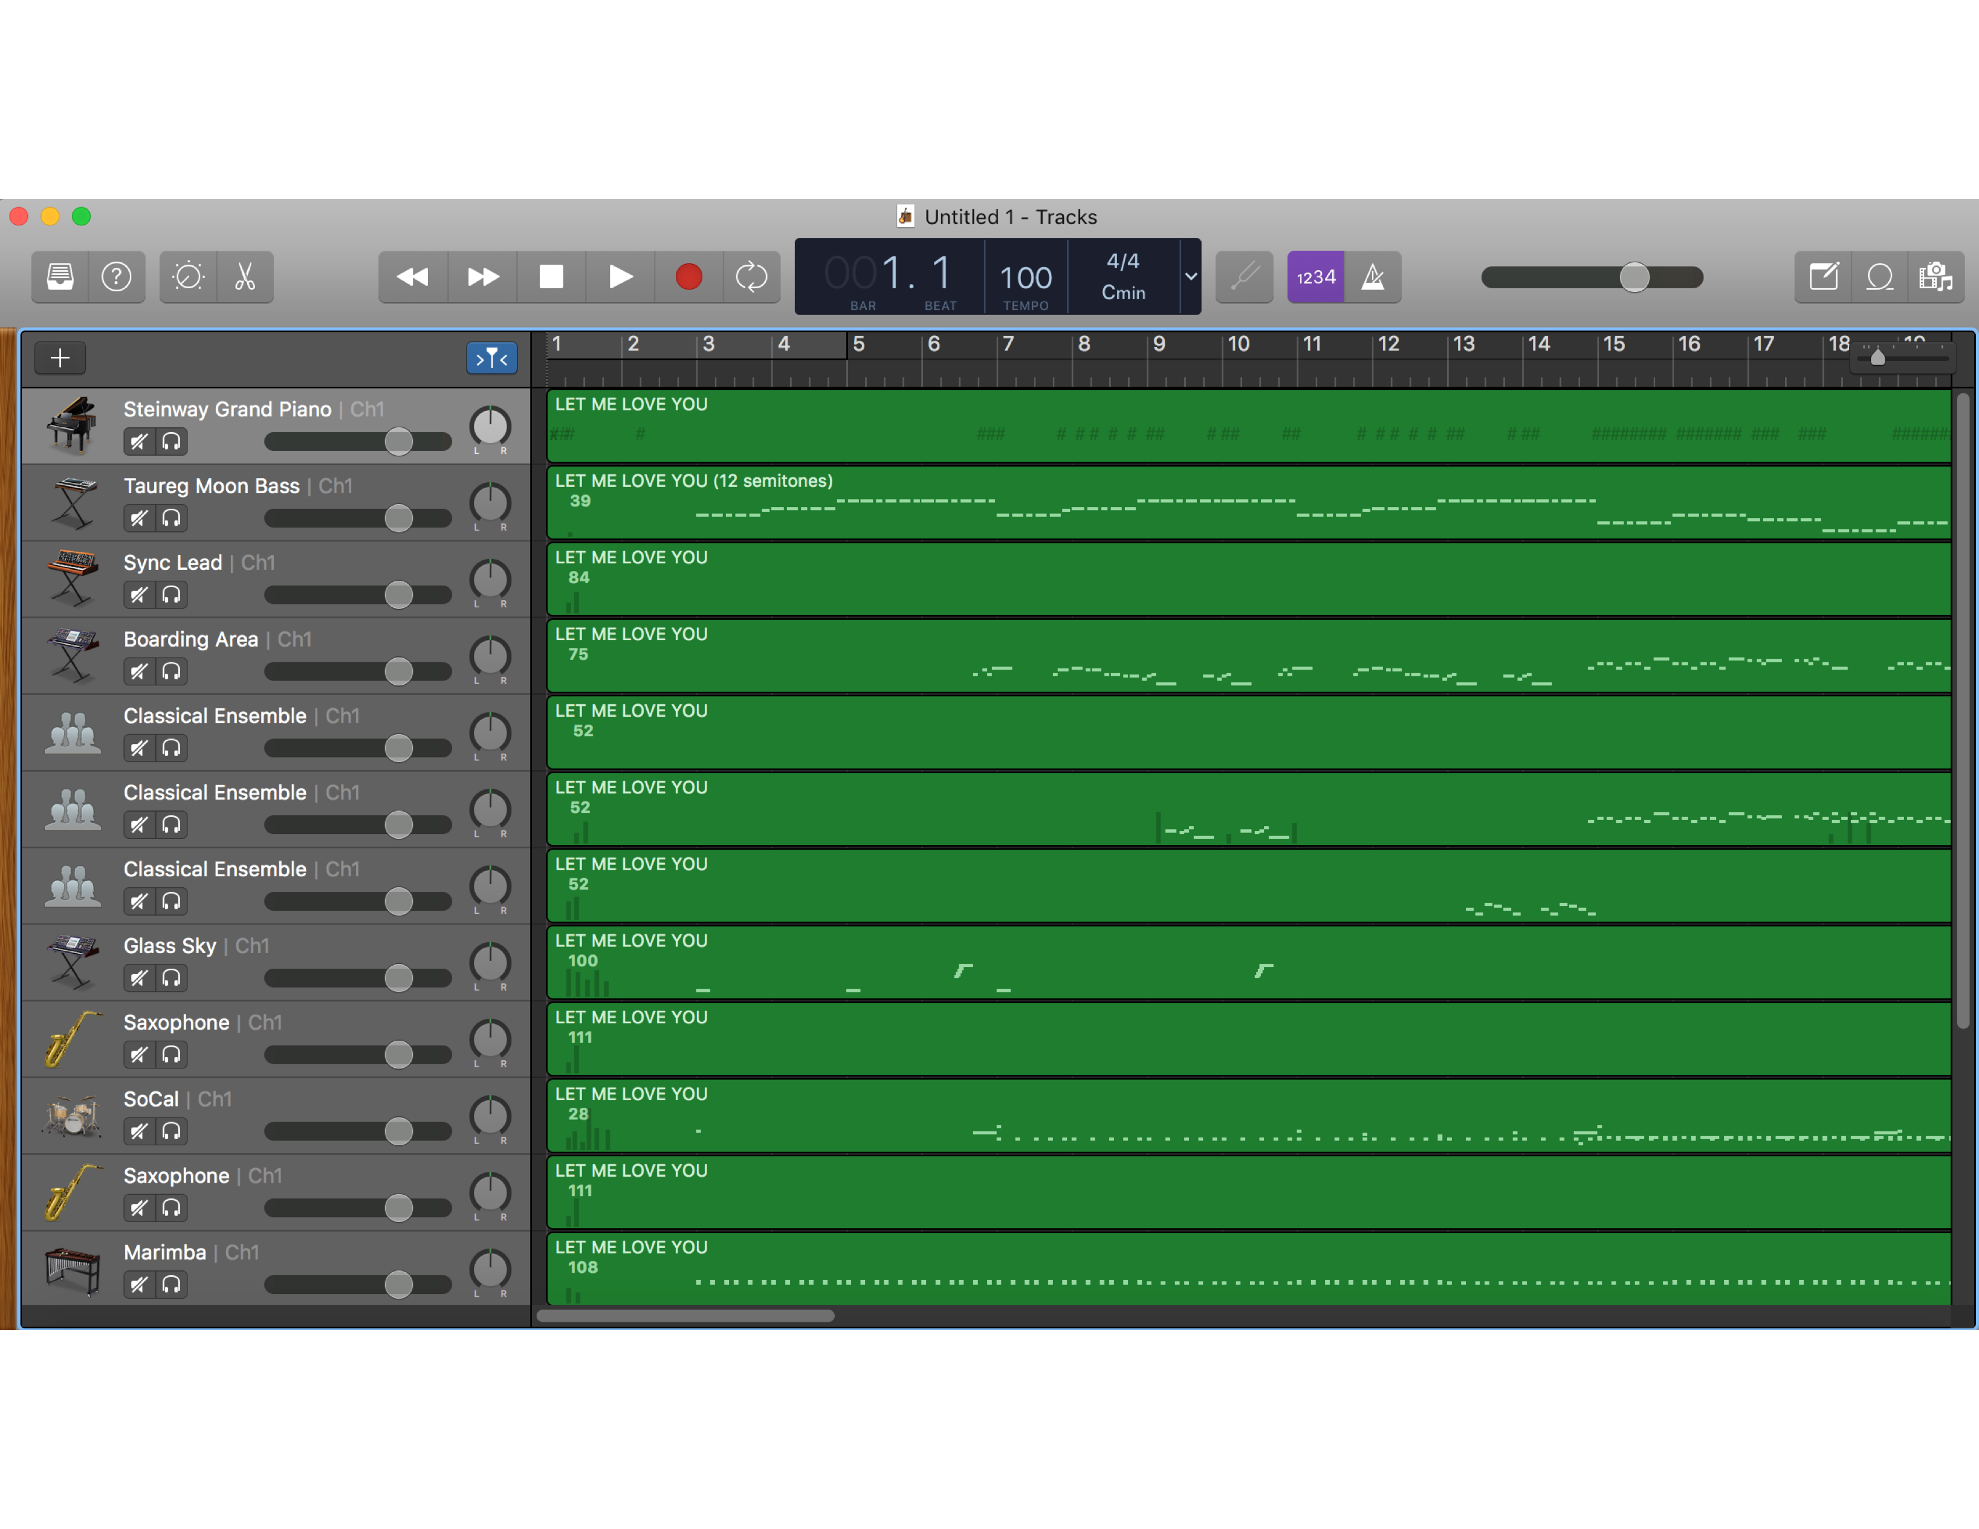
Garage Band shows a simple Midi representation

Slide 3
Matrix Representation
Time Step
1
34
Instrument(1-128)
55
Note pitch (0-127)
101
109

Slide 4
Why RNN?
Allows for the modeling of time series
Allows for connections among hidden units associated with time delay
Able to retain information about the past to find temporal correlations of separate events in the data
Images from http://www.hexahedria.com/2015/08/03/composing-music-with-recurrent-neural-networks/

Slide 5
Why add LSTM?
RNN memory by itself is still very short term
LSTM’s allow for inputs to be delayed for multiple time steps
Increases RNN memory and capability to recognize temporal patterns
Image from great video by Brandon Roher:
https://www.youtube.com/watch?v=WCUNPb-5EYI

Slide 6
Difficulties Training RNN(The Dark Arts)
RNN’s are Voldemort, and we are Harry Potter in his first year
Exploding gradient problem
Fixed with gradient clipping
Determining number of hidden layers
Determining Learning Rate
Determining number of iterations
All of these values were determined experimentally
Choose what seem like reasonable answers to start and adjust accordingly following increasing validation accuracy
Batch Size
For our data, we could batch the entire training set
Yeah, a lot of bullets on this slide

Slide 7
Exploding Gradient Problem
What is it?
Because RNN’s rollout they have many more multiplications than feed forward networks
Used for very deep feed forward networks as well
Even smaller numbers become large when they are multiplied together enough times
Solution: Gradient Clipping
Image from Udacity video:
https://www.youtube.com/watch?v=VuamhbEWEWA

Slide 8
Why Dropout?
Created by Geoffrey Hinton
Dropout is a regularization technique for reducing overfitting in neural nets by preventing complex co-adaptations on training data.
It is a very efficient way of performing model averaging with neural networks.
Makes neurons more efficient by reducing redundancy of similar neurons
Makes more generalizable to testing data by, in effect, introducing noise
Image from Udacity video:
https://www.youtube.com/watch?v=NhZVe50QwPM
https://en.wikipedia.org/wiki/Dropout_(neural_networks)

Slide 9
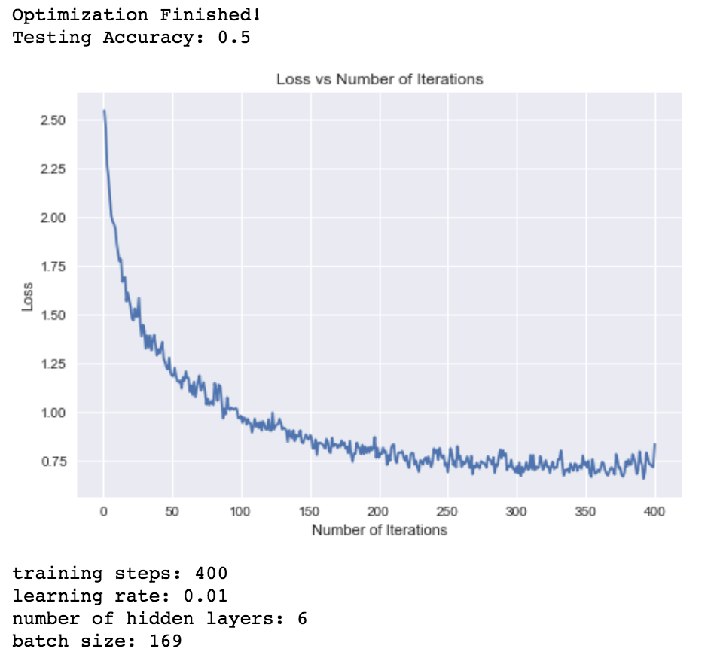
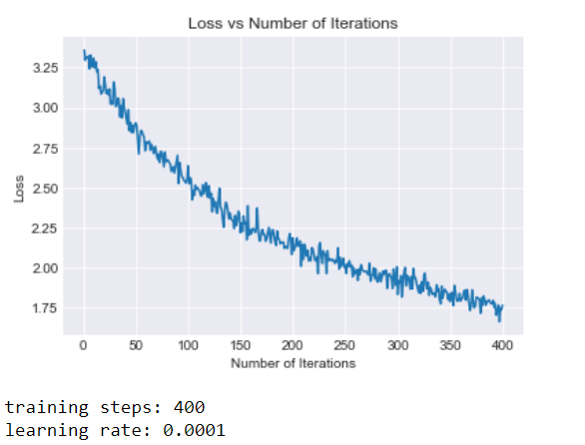
Learning Rate Just need to get a feel
0.01
0.002
0.0001

Slide 10
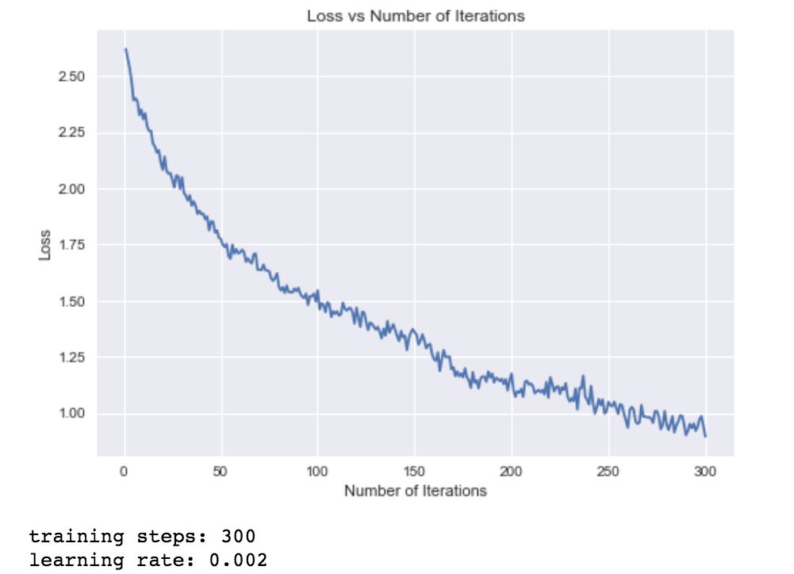
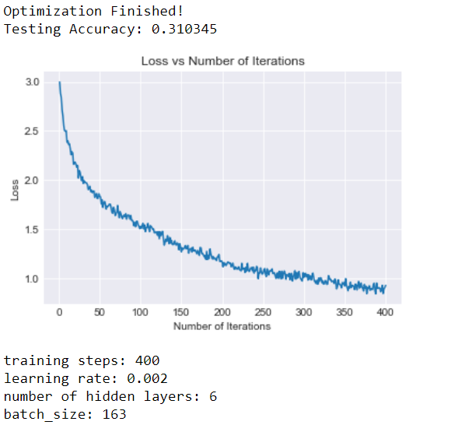
Number Iterations
300
400

Slide 11
Number Hidden Layers
6 layers
18 layers

Slide 12
Chosen Parameters for RNN
Learning Rate: 0.002
Number Hidden Layers: 18
Number Iterations: 400
Dropout: 0.9

Slide 13
Final Testing Accuracy
FINAL ACCURACY: 44.4%
3x more accurate than random
Clearly learning

Slide 14
Other Challenges
Need to learn how to store the note matrices in a form that makes feeding them into the RNN more efficient
Our RNN was very fickle in some cases
Same exact parameters could be run on the training data and have validation accuracy ranging from 30-50% with no consistency
Batch normalization is now the more accepted mode of normalization over drop out
”The cool kids aren’t dropping out any more these days” –Dr. Souvenir
Batch normalization implementation was attempted but not working in time for this deadline

Slide 15
Future Plans
Get more data
Way more
Like way more
Use this architecture to have the RNN not output predictions but instead take in a sound bite of MIDI and generate more music from it
Implement batch normalization (possibly removing dropout as a result)
Store note matrices in a more efficient fashion

Slide 16
Questions?

